Slide 1
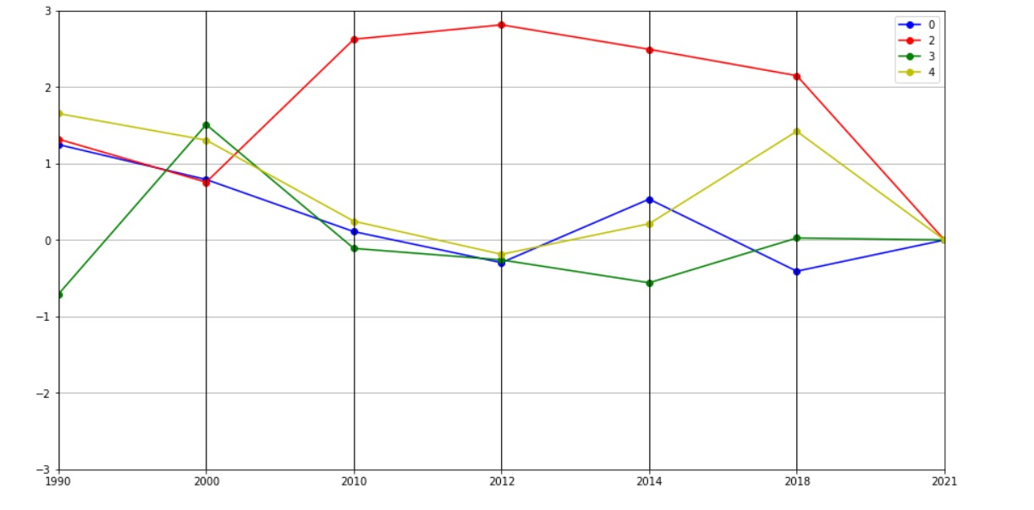
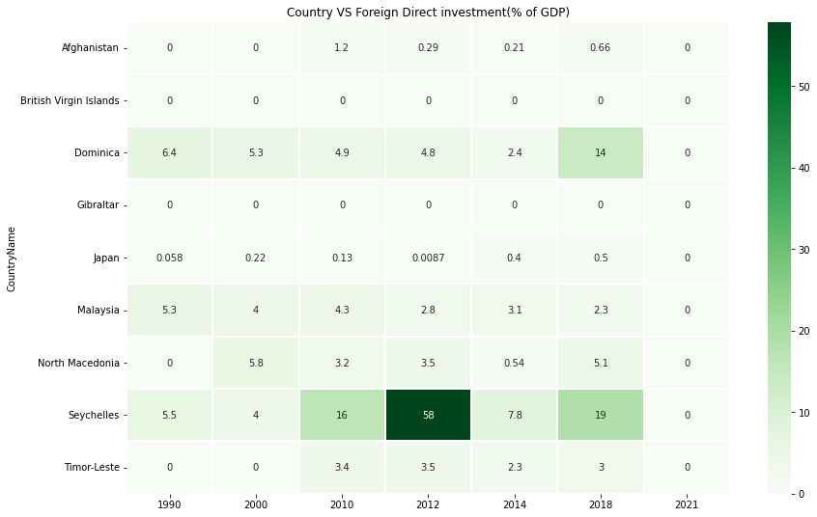
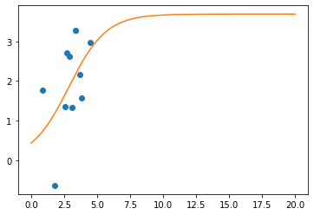
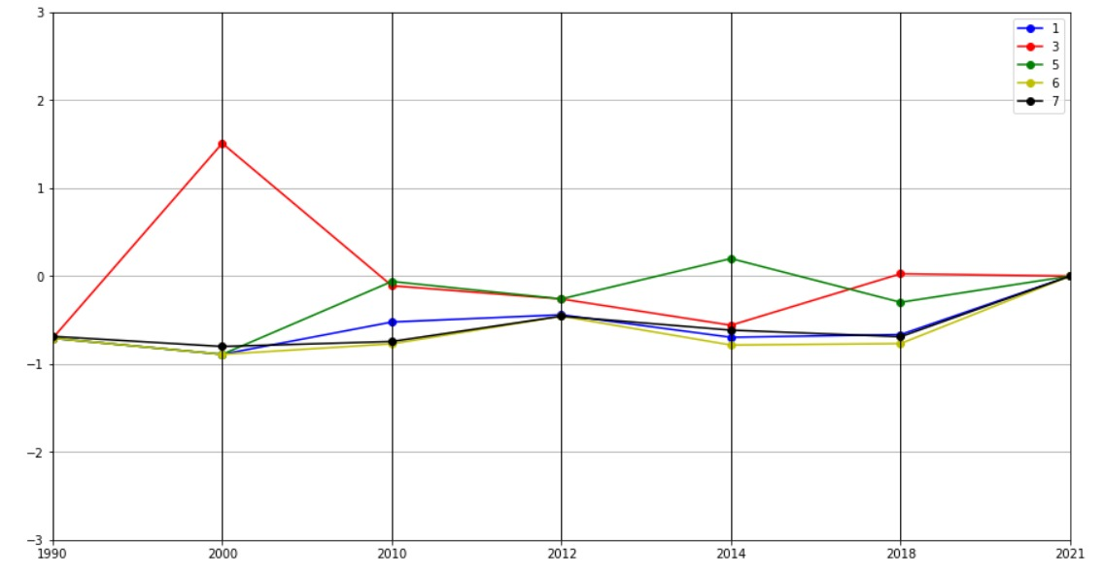
Analysing Foreign Direct Investment (FDI)
Executive Summary
The graph makes it quite clear that just five of the nine countries' data have been provided, and that the statistics for the nation that came in third place show a substantial amount of variation during the year 2000.
The different graphical representations that can be used to analyse Foreign Direct Investment (FDI) data such as heat maps, clustering processes, and fitting processes.
Heat maps can be used to quickly assess the relative levels of FDI compared to GDP for each country.
While clustering processes and fitting processes can be used to uncover trends and correlations between countries.
FDI visualisations can help identify countries that are attractive to foreign investors, as well as those that may require more attention.
Introduction
Foreign Direct Investment (FDI) is a major source of economic growth and development. FDI is defined as a long-term investment by a foreign entity in a domestic company or asset. This investment can take the form of building factories, investing in existing businesses, or buying land, among other investments. It is important for countries to understand the level of FDI as a percentage of their gross domestic product (GDP) in order to ensure that the economy is on track for growth.
The clustering graph of foreign direct investment in the year 2000 displays a promising trend. It is likely that the foreign direct investment in the four countries indicated in the graph is much higher than in the past, indicating that these countries are becoming increasingly attractive investment destinations. This could be due to factors such as the countries' attractive tax regime, the availability of skilled labour, and the presence of an enabling business environment. Furthermore, the higher foreign direct investment could result in increased economic growth in the four countries, creating more opportunities for businesses and individuals alike.
FDI % of GDP
Fitting Process
This visual representation is useful for quickly assessing the relative levels of FDI compared to GDP for each country. It is also useful for identifying countries that have higher levels of FDI than others, as well as those with lower levels. This heat map can be used to gain a better understanding of the overall FDI dynamics in different countries, as well as to identify potential investment opportunities.
The graph displays the expansion of the confidence interval, as well as the point in time when it reached a constant value. The line plot and the scatter plot both display the behaviour of the curve fit, but the scatter plot further displays the behaviour of the confidence range. This allows for a detailed analysis of the data, allowing for a more accurate representation of the logistic function. Ultimately, the plot for the curve fit helps to understand the underlying data and provides insight into the behaviour of the logistic function.
Clustering Process
Conclusion
Foreign Direct Investment (FDI) visualisations are a powerful way to gain insights into the level of foreign investment in different countries. Heat maps, clustering processes and fitting processes can be used to uncover trends and correlations between countries. Visualisations can also be used to make comparisons between countries, helping to determine which countries are more attractive for foreign investment. Furthermore, FDI data is used to evaluate a country's economic performance and identify areas of improvement. In sum, FDI visualisations are a valuable tool in understanding the level of foreign investment in different countries.
A parallel coordinates plot is utilised for clustering. It is a visualisation tool that is used to assess multivariate numerical data. Each colour represents a distinct country that is denoted in the code and is assigned a number that is specified in the legend. In the graphic, the data were categorised according to the column, or by the year 1990.

